Slide 1

Let's Try Something New:
Promoting COVID 19 Vaccine Confidence Now
Let's Try Something New:
Promoting COVID 19 Vaccine Confidence Now,
As Vaccines Become Required
September 1, 2021

Slide 2
What are the current barriers to COVID 19 vaccination for PALTC Staff?
It is not needed: “I survived working through the COVID 19 pandemic and I was fine!”
It is my choice
I am sure I already had COVID 19 / I already had the infection: So why do I need the vaccine?
I want to have children, I don’t want to risk my fertility
I am afraid of the side effects
My family and friends are not getting the vaccine, I trust my peer group
You never cared about my health before, I think you just want me to get the vaccine for you, not because you care about me, now it is just about the vaccine Mandate, not about me.
I don’t want to risk needing to take time off, losing pay
I am now embarrassed to change my mind and get the vaccine. I am going to look like I am caving just because of pressure or a vaccine mandate
I still don’t trust that the government is being truthful and that the vaccine is safe
Now I don’t trust the COVID 19 vaccine because I am
being forced to take it.

Slide 3
What are other factors that influence COVID 19 vaccination?
Language barriers
Trusted and known messengers
Cultural, religious and equity issues
Need for activating the person’s agency

Slide 4
Adjusting our Perceptions of Why Someone is Not Vaccinated
Don’t assume you know why someone is not vaccinated
Fears can be multifocal: mistrust, fear of needles, concern about side effects
  Fear of uncertainty can be more frightening than COVID 19 infection
Changing one’s mind can be unsettling: People like to view their choices as consistent, and may feel that changing their mind admits to having been “wrong”
  Positive sense of self
  Behavior change is difficult
  Solution: Connect getting the COVID 19 vaccine to other past choices, behaviors and values (wearing seatbelts, covering a wound, washing hands, quitting smoking)
Invest in Trust: A Guide for Building COVID-19 Vaccine Trust and Increasing Vaccination Rates among CNAs. AHRQ, https://www.ahrq.gov/nursing-home/materials/prevention/vaccine-trust.html

Slide 5

IT IS STILL ALL ABOUT TRUST
It is still possible to build and enhance trust–even with a vaccine mandate

Slide 6
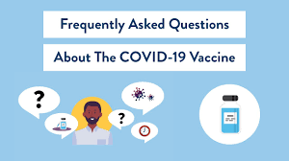
COVID 19 vaccine education and building vaccine confidence Should Not Stop just because there is a COVID 19 Vaccine mandate (Requirement)
Addressing COVID 19 vaccine concerns are more important now then ever

Slide 7

15 Strategies to use during conversations about the vaccine
Empathetic listening is one of the most important strategies you can use to increase vaccine confidence:
  1 on 1 conversations are most effective, especially for specific concerns
  People are feeling very vulnerable right now because the vaccine is now required
  Empathize with their fears but be careful not to reinforce them
Provide time and space to answer specific questions about the COVID 19 vaccine, any timelines and expectations. This is an Opportunity to show you respect and want to work with individual staff members.
Connect with their personal values and identities, for example, a passion for taking care of residents and protecting their own families.
Use personal stories instead of statistics. They are often more powerful.
Invest in Trust: A Guide for Building COVID-19 Vaccine Trust and Increasing Vaccination Rates among CNAs. AHRQ, https://www.ahrq.gov/nursing-home/materials/prevention/vaccine-trust.html

Slide 8
15 Strategies to use during conversations about the vaccine
5. Use positive emotions: The vaccine offers hope and relief from anxiety and risk of infection. It can lead to the end of the pandemic and getting back to our previous life
6. Emphasize specific benefits of getting the vaccine:
  Protection against the delta variant
  Decreased testing
  Decreased risk for children/ families
7. Listen to the reasons staff did get vaccinated (they are probably very specific) and share these reasons with your staff (bulletin board, facility letter, social media)
8. Who is doing the talking? Identify leaders who have already built trust. Trusted Staff members who were hesitant and then got vaccinated are great messengers
9. Provide information in multiple languages.
Invest in Trust: A Guide for Building COVID-19 Vaccine Trust and Increasing Vaccination Rates among CNAs. AHRQ, https://www.ahrq.gov/nursing-home/materials/prevention/vaccine-trust.html

Slide 9
15 Strategies to use during conversations about the vaccine
  10. Use multiple avenues of communication: text messages, emails, posters in break rooms, messages with paychecks, videos.
  11. Concentrate on the logistics, benefits and successes (when can staff be vaccinated, does it have to be in front of everyone, % of Staff that is vaccinated)
  12. Do not concentrate on “overcoming vaccine hesitancy” because it can lead to more apprehension.
13. Provide information on side effects if this is a concern (see next slides).
14. Provide Information on risk for fertility and pregnancy if this is a concern (see next slides).
15. If possible, offer paid time off in case side effects occur after vaccination.
Invest in Trust: A Guide for Building COVID-19 Vaccine Trust and Increasing Vaccination Rates among CNAs. AHRQ, https://www.ahrq.gov/nursing-home/materials/prevention/vaccine-trust.html

Slide 10

Reaching diverse populations with the vaccine
Black, Latinx, Asian and Native American communities have suffered disproportionately from COVID-19, so reaching these communities with the vaccine is vital.
Key is understanding what is preventing the person from getting vaccinated: logistical or psychological. The answer will guide next steps.
Acknowledge that our society’s history of racism has diminished the trust that some members of these marginalized populations may have in our healthcare institutions, and medical treatments such as the COVID-19 vaccine.
Grumbach K, Judson, T, Desai M, Jain V, Lindan C, Doernberg S, Holubar M. Association of Race/Ethnicity With Likeliness of COVID-19 Vaccine Uptake Among Health Workers and the General Population in the San Francisco Bay Area. JAMA Internal Medicine. July 2021; 181(7).

Slide 11
New Questions & Answers about the COVID 19 Vaccine
Is getting the vaccine still worth it?
  The vaccine was created to prevent severe disease, hospitalization, the need for a ventilator and death
  The COVID 19 vaccines do all these things
What about breakthrough cases? Does that mean it no longer works well?
  Breakthrough cases are expected and does not mean the vaccine has failed
  Breakthrough cases are usually mild (No hospital, ventilator or death)
What are two key statistics to know and share?
  95%-99% of COVID related hospitalizations in the U.S. are currently in people who are not fully vaccinated
  More than 99% of the people dying from COVID 19 in the U.S. are not fully vaccinated
https://www.kff.org/policy-watch/covid-19-vaccine-breakthrough-cases-data-from-the-states/

Slide 12
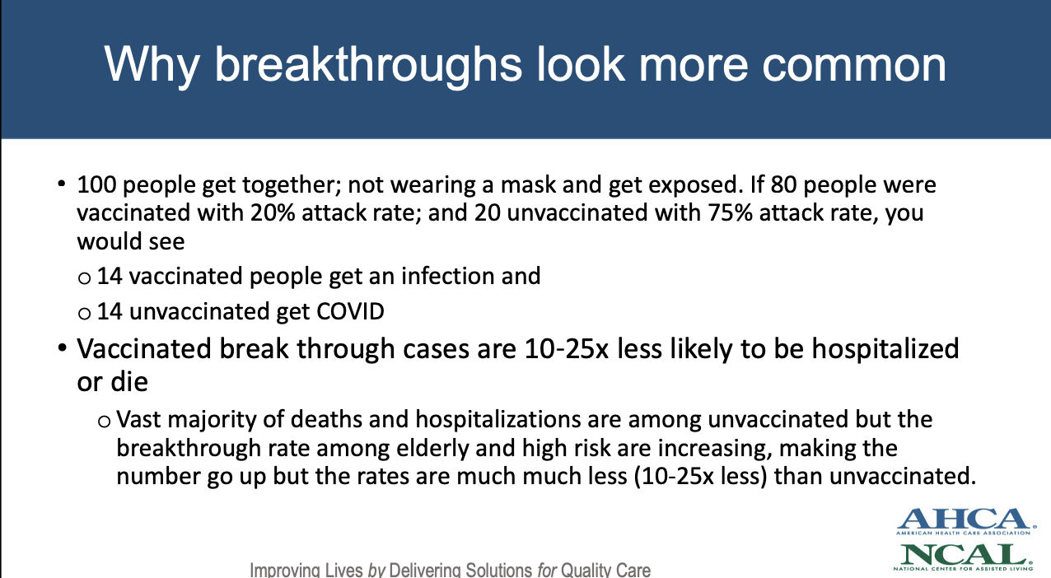

Slide 13
What about COVID 19 Vaccine Boosters?
  The ACIP (CDC advisory committee) recommends boosters for some immunocompromised people now who have received a mRNA vaccination
  It appears that boosters will now be recommended 8 months after the second mRNA vaccination and will be available starting September 20, 2021, according to the federal government
  Data released by J+J on 8/25/21 show that an additional J&J vaccination given 8 months after the initial dose resulted in a 9-fold increase in antibody response
  FDA must amend the EUA or amend already approved COVID 19 vaccines to allow for a booster shot
https://www.jnj.com/johnson-johnson-announces-data-to-support-boosting-its-single-shot-covid-19-vaccine
https://www.fda.gov/news-events/press-announcements/coronavirus-covid-19-update-fda-authorizes-additional-vaccine-dose-certain-immunocompromised

Slide 14
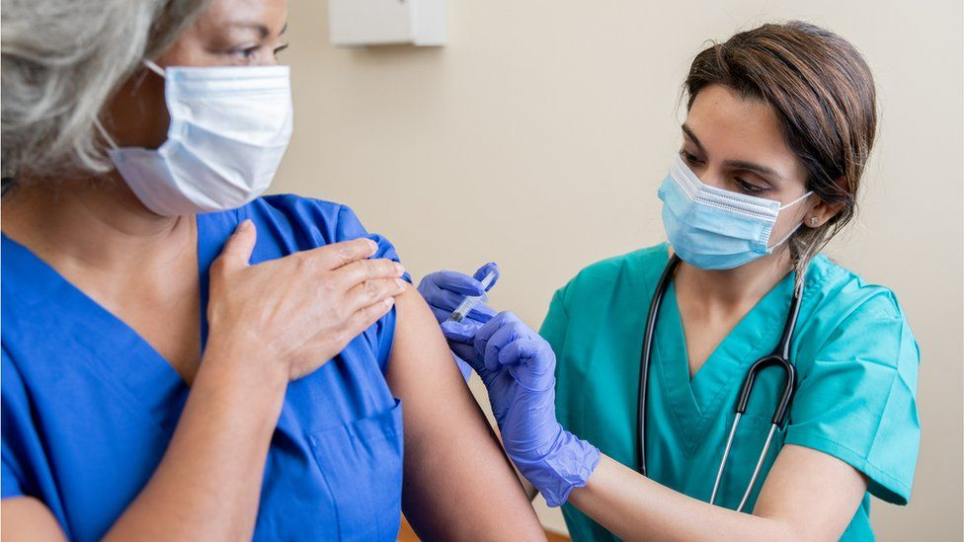
Why Should I get vaccinated if I have already had a COVID 19 infection or suspect that I did?
We don’t know how long your protection will last or how much protection you will have against new variants, like the delta variant
The immunity from the COVID 19 vaccines appears to be more durable and protective, especially against some variants that are more contagious and dangerous than the original virus.
The COVID 19 vaccines have undergone numerous trials and we continue to monitor immunity after vaccination
Antibody tests are not adequate to make a decision about getting the vaccine.
Research shows that people who had COVID-19 and get vaccinated have an enhanced immune response and strong resistance against variants of concern (JAMA, July 14, 2021)
August 6, 2021:CDC research showed Unvaccinated adults who were previously infected with COVID-19 were twice as likely to be reinfected as those previously infected but also fully vaccinated
  You have incomplete protection if you have had a past COVID 19 infection but no vaccination
MMWR: https://www.cdc.gov/mmwr/volumes/70/wr/mm7032e1.htm?s_cid=mm7032e1_w
https://jamanetwork.com/journals/jama/fullarticle/2782139?guestAccessKey=70cac40b-0f82-4e56-a96a-eadc0942a934&utm_source=silverchair&utm_medium=email&utm_campaign=article_alert-jama&utm_term=mostread&utm_content=olf-widget_07162021

Slide 15
Social Media Medical Misinformation and Disinformation
There is a parallel between how the COVID 19 virus spreads and how information spreads
  There can be super spreader events for misinformation and disinformation
    Large platform, many followers
    Hydroxychloroquine /Ivermectin
Immunize people against rumors and misinformation
  Prepare people but don’t give the rumor “legs to run”
Why can misinformation spread faster than correct information?
  It is a novelty
  Status in sharing information that is “Novel”
  Dr Seema Yasmin, https://edhub.ama-assn.org/stanford-medicine-cme/audio-player/18592150?utm_source=silverchair_edhub&utm_campaign=activity_alert-edhub&utm_content=weekly_batch&cmp=1&utm_medium=email

Slide 16
Addressing Social Media and Medical Misinformation
Strategies to address social media misinformation:
  Don’t take the misinformation personally
  Listen first. People want to be heard
  Show respect
  Celebrate the fact that the person trusts you enough to have a conversation
  The goal is not to prove them wrong
Brian Southwell, PhD, https://edhub.ama-assn.org/jn-learning/audio-player/18571804?utm_source=silverchair&utm_campaign=jama_network&utm_content=covid_weekly_highlights&cmp=1&utm_medium=email

Slide 17
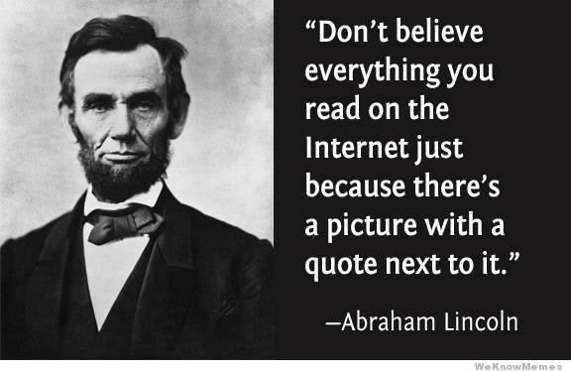
How to Address Social Media Misinformation
Try to assess why the information is speaking to the person
Take the opportunity to redirect them to more trustworthy information sources and explain to them what we know medically
Ask them to consider:
  Where is this information coming from?
  Is it gaining popularity because it is sensationalized?
  Is it a fact? Has it been proven?
Brian Southwell, PhD, https://edhub.ama-assn.org/jn-learning/audio-player/18571804?utm_source=silverchair&utm_campaign=jama_network&utm_content=covid_weekly_highlights&cmp=1&utm_medium=email

Slide 18
Leading a conversation about what’s on social media regarding the COVID-19 vaccine…
Acknowledge the concern
  “I see you have been thinking about this a lot”
  Encourage discussion. Don’t shut them down
Ask Questions
  “Tell me where you heard about this information”
  “Do you trust the source?”
Never be condescending, this is a person who is trusting you to have a conversation. Avoid using strongly negative words like “No” or judgmental responses like “That’s crazy!”
Offer to trade sources. “This is where I get my information…”
Explain what you know medically and where you found the information
  “That is a good question, let’s talk that through.”
Again, the point is not to prove them wrong
EChO:

Slide 19
Realistic expectations for a COVID 19 vaccine conversation
The COVID 19 pandemic is still stressful, anxiety producing, and apprehension is expected
Resistance to change is normal
  People can have feeling of fear and uncertainty
  Avoid getting into a dueling match, “I am right and you are wrong”
  Instead, invite people to explore their own sources of resistance rather then confronting them
  See resistance as an opportunity for exploration
Understand different communities may have different relationships to vaccination
  Show up ready to acknowledge and respect people’s lived experiences
COVID 19 Vaccine Safety is still a significant concern
  lack of confidence in vaccine safety was cited as the most common single factor for peoples COVID 19 vaccine hesitancy (July 29,2021)
IHI Conversation Guide to Improve COVID-19 Vaccine Uptake, http://www.ihi.org/resources/Pages/Tools/conversation-guide-to-improve-COVID-19-vaccine-uptake.aspx
https://catalyst.nejm.org/doi/full/10.1056/CAT.21.0162

Slide 20
You Do Not have to Seal the Deal at the end of a COVID 19 Vaccine Conversation!
  Leaving the door open for staff to make their own decision, their own choice, is often more successful, even if there is a vaccine requirement.

Slide 21
Side Effects of the Pfizer, Moderna and Johnson & Johnson Vaccines
Short-Term Side Effects—1-2 days after the vaccine:
  Fever
  Fatigue
  Headache
  Pain at the injection sight
  More common after the second dose of the Pfizer and Moderna vaccines
  These side effects show that the vaccine is working and your body is making antibodies to protect you against a COVID 19 infection
Risk of Anaphylaxis:
  Pfizer: 4.7 cases per million
  Moderna: 2.5 cases per million
Risk of Blood Clots with Johnson & Johnson Vaccine:
  1.9 per million doses
  7 per million for women < 50 years old
  KEY MESSAGE: The risk of getting a blood clot with a COVID 19 infection is far greater than the risk of a blood clot with the J & J vaccine
Reports of Anaphylaxis After Receipt of mRNA COVID-19 Vaccines in the US—December 14, 2020-January 18, 2021 Published Online: February 12, 2021. doi:10.1001/jama.2021.1967
https://www.cdc.gov/mmwr/volumes/70/wr/mm7017e4.htm?s_cid=mm7017e4_w

Slide 22
Side Effects to the Pfizer, Moderna and Johnson & Johnson Vaccines
Myocarditis/Pericarditis with mRNA COVID 19 vaccines:
  extremely rare side effect, approx. 4.8 per million
  Myocarditis occurred mostly in male adolescents and young adults aged 16 years or older, after the second dose
  Pericarditis affected older patients later, after either the first or second dose
  myocarditis and pericarditis are much more common if you become infected with COVID 19
  most often improve quickly
  https://www.cdc.gov/vaccines/covid-19/clinical-considerations/myocarditis.html
  https://jamanetwork.com/journals/jamacardiology/fullarticle/2781601
  https://jamanetwork.com/journals/jama/fullarticle/2782900?guestAccessKey=f82a068c-369d-4e51-8632-6a21a9bf850b&utm_source=silverchair&utm_medium=email&utm_campaign=article_alert-jama&utm_content=olf&utm_term=080421
Guillain-Barré Syndrome risk with Johnson & Johnson vaccine:
  EUA Fact Sheet: increased risk of Guillain-Barré syndrome during the 42 days following vaccination
  https://jamanetwork.com/journals/jamaneurology/fullarticle/2783708
  https://www.fda.gov/media/146304/download
  Guillain-Barré Syndrome is also associated with COVID 19 Infection
  As per the ACIP, GBS occurs mostly within 2 weeks of vaccination, mostly in older men, median age 57
  https://www.cdc.gov/vaccines/acip/meetings/downloads/slides-2021-07/02-COVID-Alimchandani-508.pdf
  https://www.nejm.org/doi/full/10.1056/NEJMc2009191

Slide 23

Is the COVID 19 vaccine safe to take if I am pregnant or planning to become pregnant?
Studies show all the COVID 19 vaccines are safe for pregnant women
  No increased risk for miscarriage, premature births or other complications
CDC recommends COVID 19 vaccination for pregnant women or before pregnancy if possible:
  “Vaccination programs should target women early in pregnancy or before conception, if possible.”
  “CDC analysis of safety data on 2,500 women showed no increased risks of miscarriage for those who received at least one dose of the Pfizer or Moderna vaccine before 20 weeks of pregnancy.”
The American College of Obstetricians and Gynecologists and the Society for Maternal-Fetal Medicine recommend COVID-19 shots for all pregnant women
https://wwwnc.cdc.gov/eid/article/27/10/21-1394_article
https://www.researchsquare.com/article/rs-798175/v1
https://www.acog.org/covid-19/covid-19-vaccines-and-pregnancy-conversation-guide-for-clinicians

Slide 24
Does the COVID 19 vaccine cause sterility or infertility?
“There's no evidence or even biologic plausibility that COVID 19 vaccines cause infertility in either men or women” – Denise J. Jamieson, MD, MPH, professor and chair, Department of Gynecology & Obstetrics, Emory University School of Medicine; member, ACOG Practice Advisory on COVID-19 Vaccines and Pregnancy
People who have received any of the 3 COVID 19 vaccines have not had any increased complications with pregnancy compared to before the pandemic began
https://www.ama-assn.org/delivering-care/population-care/denise-jamieson-md-mph-covid-19-vaccines-during-pregnancy

Slide 25
What about Incentives?
They can be helpful but are much more effective if they make sense
  Paid time off to get the vaccine
  Paid time off if the person has a side effect
  Bounce PTO, an acknowledgement of long hours worked
Staff also state that they would like to be acknowledged that they are doing their part to keep their community and residents safe
Ironically, the Ohio lottery incentive did not significantly increase adult COVID-19 vaccination rates
Invest in Trust: A Guide for Building COVID-19 Vaccine Trust and Increasing Vaccination Rates among CNAs. AHRQ, https://www.ahrq.gov/nursing-home/materials/prevention/vaccine-trust.html
Lottery-Based Incentive in Ohio and COVID-19 Vaccination Rates, July 2,2021: https://jamanetwork.com/journals/jama/fullarticle/2781792?resultClick=1

Slide 26
What can we do now?
Activate People’s AGENCY!
Agency is the ability of an individual or group to Choose to act with purpose
Need both Power and Courage
  Courage to act in the face of difficulty or uncertainty
Understand each person has their own agency to make their own choice
  Personalize the conversation, Talk about why the person is important to the residents and the facility,
Activate someone’s Agency by appealing to their expertise and pride of work (CNAs and nurses have profound expertise)
IHI Conversation Guide to Improve COVID-19 Vaccine Uptake, http://www.ihi.org/resources/Pages/Tools/conversation-guide-to-improve-COVID-19-vaccine-uptake.aspx
Invest in Trust: A Guide for Building COVID-19 Vaccine Trust and Increasing Vaccination Rates among CNAs. AHRQ, https://www.ahrq.gov/nursing-home/materials/prevention/vaccine-trust.html

Slide 27
Motivational Interviewing
What is it?
A person-centered conversation to address the common problem of ambivalence about change
To strengthen a person’s own motivation and commitment to change
Definitions of Motivational Interviewing and the Four Processes adapted from Miller W, Rollnick S. Motivational Interviewing: Helping people change. 3rd ed. New York:Guilford Press; 2012.
How do you do it?
Engage: build and support a relationship where trust and respect go both ways
Focusing: ongoing process of choosing and keeping a specific direction
Evoking: bringing out one another’s strengths, knowledge and ideas about the situation
Planning: being with someone while they form a specific action to take

Slide 28
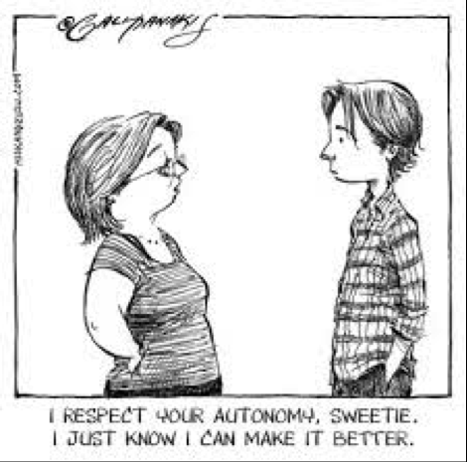
The Spirit of Motivational Interviewing
Compassion – caring about what is important to another person and feeling moved to help
Acceptance – respecting another person and their right to change or not change
Partnership – working with another person and recognizing them as equal
Evocation – bringing out another person’s ideas, strengths and knowledge about the situation and themselves. This can include encouraging to explore.
Miller W, Rollnick S. Motivational Interviewing: Helping people change. 3rd ed. New York:Guilford Press; 2012

Slide 29
Find New and Innovative Ways to Engage Staff
Create
Create an COVID 19 question box where Staff can place anonymous, written questions for the Medical Director to answer
Update
When the situation with COVID 19 is changing, keep staff up to date with in-services, town halls, huddles (SDC, Medical Director)
Continue
Continue to offer COVID 19 vaccinations individually to unvaccinated staff so they can express concerns or questions privately and be able to pivot / change their mind in privacy
Remind
Remind everyone that vaccinated people are not getting severely ill, needing hospitalization or dying from COVID 19 infections –The vaccine is working!

Slide 30
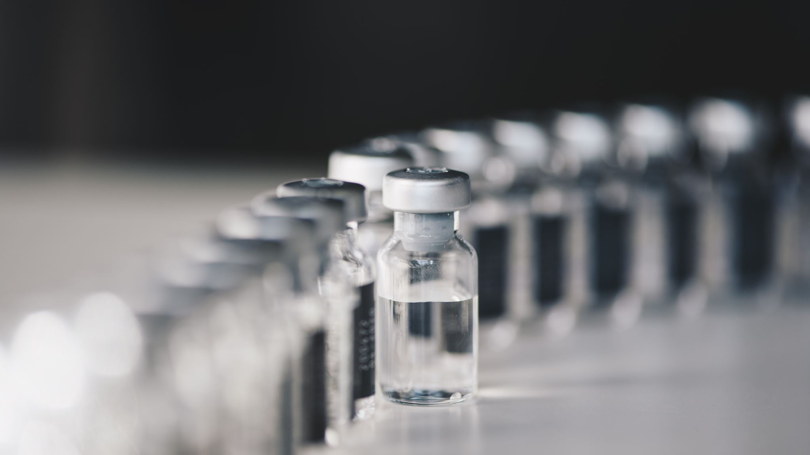
COVID 19 Vaccine Confidence is the Goal!

