Slide 1
Dental Care in the Nursing Home
Antibiotic Prophylaxis
Anticoagulant Management
Antibiotic Indications
Dr. Melissa Musolf DDS
Notes:
Dr. Musolf has a DDS Degree from the Marquette School of Dentistry. She practiced at a level one trauma center in Fresno California for 2 years and then moved into corporate dentistry for several years. She eventually opened her own practice. She "retired" in 2021 and since that time has worked with Visiting Ancillary Services (VAS) which is a nonprofit organization. She is also a member of the Spear Institute dedicated to excellence and continued education in dentistry.

Slide 2
AHA Recommendations for Infective Endocarditis Antibiotic Prophylaxis
Prosthetic Cardiac Valve or Prosthetic Material Used for Cardiac Valve Repair or Other Implantable Cardiac Devices Such as Transcatheter Aortic Valve Implantation
Transcatheter valve replacement patients warrant antibiotic prophylaxis
Prosthetic material used for cardiac valve repair, such as annuloplasty rings
Previous, Relapse, or Recurrent IE
Previous IE puts a patient at higher risk for recurrence and bad outcomes
Congenital Heart Disease
Either unrepaired or repaired with prosthetic material, ﻿﻿unrepaired cyanotic congenital heart disease, including palliative shunts and conduits﻿﻿, repaired congenital heart defect with residual shunts or valvular regurgitation at the site of or adjacent to the site of a prosthetic patch or a prosthetic device
Cardiac Transplant Recipients
Immunosuppression and overall high risk for adverse outcome from IE
Prevention of Viridans Group Streptococcal Infective Endocarditis: A Scientific Statement From the American Heart Association (ahajournals.org)

Slide 3
Antibiotic Prophylaxis for Dental Procedures
No Antibiotic Prophylaxis Needed:
Stents
Mitral valve prolapse
Heart murmur
Pacemaker / Defibrillator
Prosthetic Joints
There will always be exceptions.

Slide 4
Antibiotics for Prophylaxis
Typically given 30-60 minutes prior to procedure.
Can be given up to 2 hours after the procedure.
Oral Antibiotics
Amoxicillin
Penicillin or Ampicillin Allergy: Cephalexin, Azithromycin, doxycycline
Clindamycin is no longer recommended by ADA or AHA.
Oral surgeons sometimes use IV antibiotics: Ampicillin, cefazolin, ceftriaxone

Slide 5
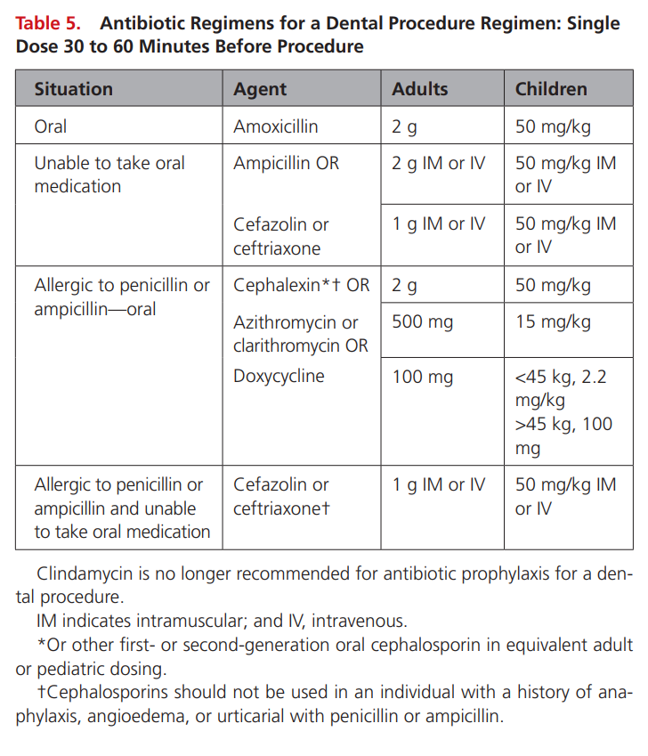
Prevention of Viridans Group Streptococcal Infective Endocarditis: A Scientific Statement From the American Heart Association (ahajournals.org)

Slide 6
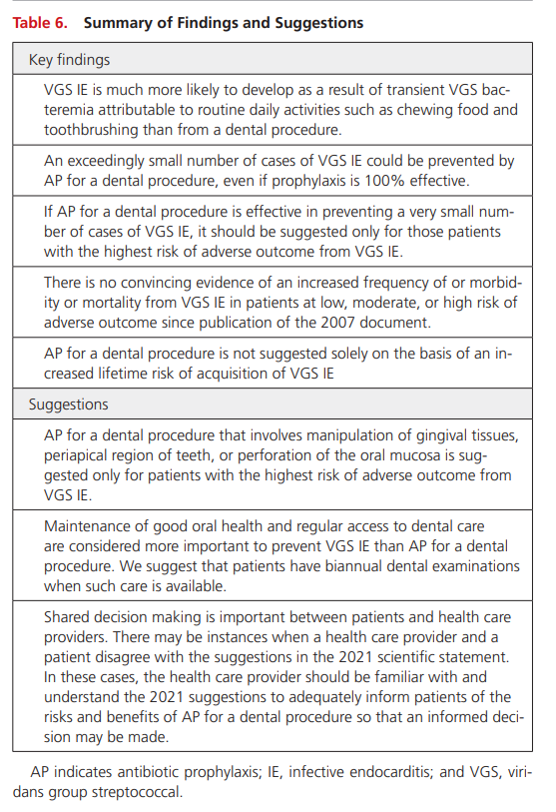
Prevention of Viridans Group Streptococcal Infective Endocarditis: A Scientific Statement From the American Heart Association (ahajournals.org)

Slide 7
Antibiotic Prophylaxis Questions
When are prophylactic antibiotics needed prior to dental cleaning?
Are prophylactic antibiotics needed prior to dental extractions?
Does a patient with a heart murmur require antibiotic prophylaxis?
- Mechanical Valve?
- Bioprosthetic valve?
Does a patient with a prosthetic joint require antibiotics prophylaxis prior to a cleaning or tooth extraction?

Slide 8
Oral Anticoagulant and Antiplatelet Medications and Dental Procedures | American Dental Association (ada.org)
“For most patients, it is not necessary to alter anticoagulation or antiplatelet therapy prior to dental intervention” -ADA
DOACS
Limited evidence
Consensus that DOACs do not need to be stopped for those with normal bleeding risk.
For patients with high bleeding risk or undergoing more extensive procedures, consideration may be given to interrupting therapy for 24-48 hours.
Extraction of 3 or more teeth
Local measures to help with coagulation: suturing, teabags and use of gel foam.
Ref: Oral Anticoagulant and Antiplatelet Medications and Dental Procedures | American Dental Association (ada.org)

Slide 9
Anticoagulation Questions
Does Eliquis or warfarin need to be stopped for cleanings?
Does it need to be stopped for dental extractions?
What procedures would be an indication to stop warfarin, eliquis, xarelto?

Slide 10
Dental Infections
Odontogenic
Periodontal (gum) infection
Infection of the gums and tissues that hold a tooth in place.
Dental Infection Antibiotics Guidelines for Pain and Swelling | American Dental Association (ada.org)

Slide 11
Dental Infections - StatPearls - NCBI Bookshelf (nih.gov)
The standard of care for dental infections is surgically controlling the infection source.
Antibiotics play a secondary role in the management of dental infections. They are only prescribed as adjuvants to surgical treatment when patients show signs of local or systemic spread of infection, including cellulitis, fever, lymphadenopathy, or fatigue. In this case, antibiotics can be prescribed before referral.
Dental infections originate in the tooth or its supporting structures and can spread to the surrounding tissues.
Dental infections most commonly occur when bacteria invade the pulp and spread to surrounding tissues. Infections can also affect the gums, causing gingivitis, which can later cause periodontal disease.
More serious complaints such as fever, facial edema, trismus, dysphagia, or dysphonia can be symptoms of a more serious dental infection that has spread into deep neck spaces.
CT with contrast can help evaluate the extent and severity of fascial space infection.
Drainage and removing the source of infection are the most important steps in treating dental infections.
Severe complications from dental infections are rare. They include osteomyelitis, Ludwig angina, retropharyngeal abscess, parapharyngeal abscess, necrotizing mediastinitis, cavernous sinus thrombosis, meningitis, and subdural empyema.

Slide 13
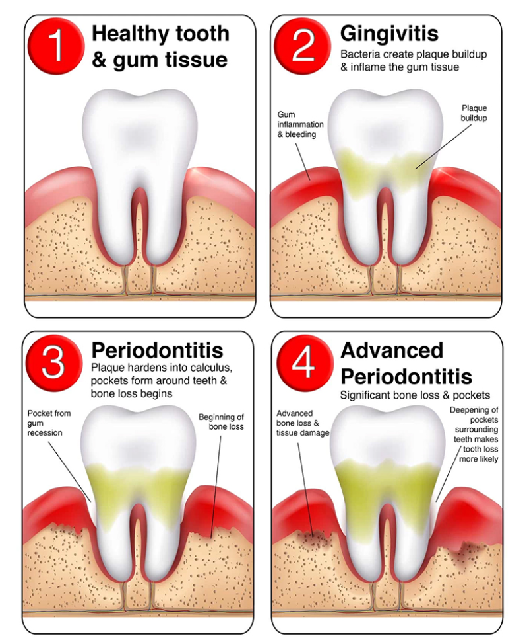

Slide 14
Odontal/Periodontal Questions
Can we treat dental caries with antibiotics alone?
If it takes weeks to get a patient to the dentist, is a course of Augmentin a worthwhile temporizing measure?
What is the best method / medication to manage dental pain?

Slide 15
References
Antibiotic Prophylaxis Prior to Dental Procedures | American Dental Association (ada.org)
Oral Anticoagulant and Antiplatelet Medications and Dental Procedures | American Dental Association (ada.org)
Dental Infection Antibiotics Guidelines for Pain and Swelling | American Dental Association (ada.org)
Prevention of Viridans Group Streptococcal Infective Endocarditis: A Scientific Statement From the American Heart Association (ahajournals.org)
Dental Infections - StatPearls - NCBI Bookshelf (nih.gov)

Slide 16
Additional Material / References

Slide 17
Evidence-based clinical practice guideline on antibiotic use for the urgent management of pulpal- and periapical-related dental pain and intraoral swelling - The Journal of the American Dental Association (ada.org)
2019 Expert panel convened by the ADA Council on Scientific Affairs and the Center for Evidance-Based Dentristy.
Systematic Review
Conclusion:
“Evidence suggests that antibiotics for the target conditions may provide negligible benefits and probably contribute to large harms. The expert panel suggests that antibiotics for target conditions be used only when systemic involvement is present and that immediate DCDT should be prioritized in all cases.”

Slide 18
The use of prophylactic antibiotics prior to dental procedures in patients with prosthetic joints - The Journal of the American Dental Association (ada.org)
The 2014 Panel made the following clinical recommendation:
In general, for patients with prosthetic joint implants, prophylactic antibiotics are not recommended prior to dental procedures to prevent prosthetic joint infection.
The practitioner and patient should consider possible clinical circumstances that may suggest the presence of a significant medical risk in providing dental care without antibiotic prophylaxis, as well as the known risks of frequent or widespread antibiotic use. As part of the evidence-based approach to care, this clinical recommendation should be integrated with the practitioner’s professional judgment and the patient’s needs and preferences.

Slide 19
Quantifying the risk of prosthetic joint infections after invasive dental procedures and the effect of antibiotic prophylaxis - The Journal of the American Dental Association (ada.org)
Case-crossover analysis; n= 2,344
No significant association between invasive dental procedures and and no effect of antibiotic prophylaxis to reduce the risk of late periprosthetic joint infections
“In the absence of benefit, the continued use of AP poses an unnecessary risk to patients from adverse drug reactions and to society from the potential of AP to promote development of antibiotic resistance. Dental AP use to prevent LPJIs should, therefore, cease.”

Slide 20
World workshop on oral medicine VII: Direct anticoagulant agents management for invasive oral procedures: A systematic review and meta-analysis - PubMed (nih.gov)
Meta-analysis; 21 studies; No RCTs.
OR of 0.92 (95% CI = 0.37-2.27, I2 = 9%) for postoperative bleeding events for patients taking DOACs.
59/497 (11.8%) postoperative bleeding events occurred in patients who continued DOACs
27/200 (13.5%) events were reported for patients who discontinued treatment.
All postoperative bleeding events were controlled with local measures.
Results from the included studies did not discern any important differences in postoperative bleeding events in patients who continued versus patients who discontinued DOACs. Furthermore, no thromboembolic events were recorded. However, the low quality of the studies must be considered.

Slide 21
