Slide 1
Hospice, SNFs and cms regs: Harmonic convergence, or clash of worlds?
Mike Towbin, MD

Slide 2

Agenda
Quick Overview of Hospice
Where’s the Tension?
Specific Areas of Conflict
A Few Other Odds and Ends

Slide 3

Hospice 101
Six months life expectancy
No life-prolonging or curative treatments
Hospice is responsible to provide medications, treatments, equipment, etc… related to the terminal diagnosis and prognosis
IDT: RN case manager, SW, CNA, chaplain, volunteer, physician
Overarching goals are comfort and dignity of the patient, plus care for the family and post-death bereavement services (> 1 year).
Pt. is recertified at 3 months, 6 months, and every two months thereafter.
Four levels of care: Routine (home, SNF, ALF), Respite (SNF, IPU), GIP (IPU, SNF, hospital) and Continuous Care (home, ALF).

Slide 4
Goals: are they compatible?
Hospice
SNF
CMS
Comfort and Dignity
Beneficence, autonomy.
Double effect is OK when necessary.
Fairly frequent “off-label” med usage
Interdisciplinary Team (IDT) is the functional “caring unit”
Welfare and shelter of vulnerable denizens
Justice (fairness, equity), non-maleficence, utilitarianism.
Avoid “tags”, watch the QIs.
Staffing model, teams often organized by unit, hallway.
Stewarding governmental resources, protecting populations.
Utilitarianism, non-maleficence.

Slide 5
Pain:
Striking the balance

Slide 6

Pain Treatment in SNFs
PRN vs. Scheduled medications
Dependent on staff to “judge”—risk of undermedication
Routine medication risks overmedication
Short-acting opioids not ideal for chronic pain.
”Dosefinding” is an art. Convert short-acting and PRNs to long-acting when appropriate.
Avoid dose and time ranges (Morphine 5-10 mg PO q4-6 hours prn pain)
Instead: Morphine 5 mg PO q4h prn moderate pain or dyspnea 5-7/10. Morphine 10 mg PO q4h prn severe pain or dyspnea 8-10/10.

Slide 7
Nausea/emesis:
Striking the balance

Slide 8

Nausea Treatment in SNFs
PRN vs. Scheduled medications
Dependent on staff to “judge”—risk of undermedication
Routine medication risks overmedication
Ondansetron (5-HT3 receptor antagonist) has ODT delivery. Usually try this first. QT syndrome; constipation.
Haloperidol (D2 receptor antagonist) is very potent antiemetic. Liquid concentrate PO or SL.
Consider olanzapine for longer-acting anti-nausea option (also has ODT option).
Metoclopramide (central and peripheral dopamine receptor antagonist) can help with vomiting and constipation.

Slide 9
Agitation/bpsd:
Striking the balance

Slide 10

AgitationTreatment in SNFs
PRN vs. Scheduled medications
Must avoid PRN use of benzos in SNF; must document why PRN is needed, limit 14 days (must have stop date); re-evaluate and seen in person by provider to continue.
PRN antipsychotics are not an option (exception for nausea medication—see previous slide—but document clearly).
Dependent on staff to “judge”—risk of undermedication
Routine order risks overmedication

Slide 11
Wound management:
Striking the balance

Slide 12
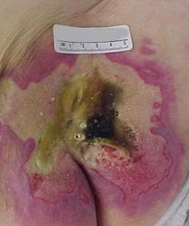
Wound Treatment in SNFs
Focus on Goals: Comfort and Dignity
Manage pain—consider topical opioid—liquid-soaked gauze or crush oxycodone tabs (15 mgs) and sprinkle in wound.
Manage odor (reduce bacterial burden—topical metronidazole tabs crushed/sprinkle, silver, Dakin’s or TAS)
Manage drainage (drying agent, absorptive agents, eg; calcium alginate)
Manage expectations of patient and family.
Wound specialist, VAC, debridement are almost never needed.
Bleeding: consider hemostatic gauze

Slide 13
Therapies for hospice patients in SNFS:
Striking the balance

Slide 14
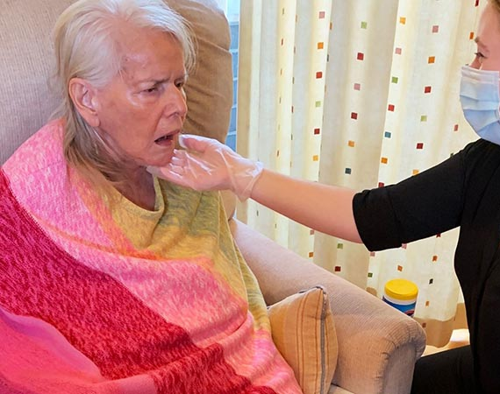
Therapies in SNFs
Focus on Goals: Comfort and Dignity
Hospice must approve and pay.
Appropriate for short-term goals with clear endpoints (eg; OT/PT for transfer needs, ST for diet upgrade or downgrade or dysphagia recommendations)
Order is written for specific units (each is 15 minutes) or time. Eg; “Speech Therapy evaluation up to 3 units/45 minutes for diet consistency recommendations”.

Slide 15
Odds and Ends
Life Expectancy
Keep Focusing on Goals
Families always want to know.
Give ranges: minutes to hours, hours to days, days to weeks, etc…
Remind them to say the important things, even if loved one is comatose (“hearing is last sense to go”).
“Thank you.”
“I forgive you…”
“Please forgive me…”
“I love you.”
“Goodbye.”
Most people do want comfort and dignity,…
…but some value wakefulness and communication more so.

Slide 16
Odds and Ends
Hospice in Your Building
Consider Alternate Routes of Medications and Levels of Care
Get to know the hospice agency/agencies in your buildings.
Call the medical director of the hospice when issues come up—regulatory, symptom management, therapy needs, etc…
VB does not credential hospice providers, so changes in hospice orders should go to the PCP before going into effect.
Would you allow a SQ or IV pain infusion or PCA?
Would you allow rectal administration of meds using a Macy Catheter?
If so, would patient/family be best served with patient on GIP level of care? Is hospice prepared for this level of care in your building?

Slide 17



Questions?

Slide 18




Thank you
Mike Towbin, MD
michael.towbin@pathways-care.org
303-819-7644

